Slide 1

HamiKissan Growing a Food-Secure Nepal.
-By Team Qubits
TEAM Qubits

Slide 2
TEAM Qubits
Problems

Slide 3
01
Problems
Source:- (src: nepalindata.com) …

Slide 4
Problems
Significant Crop Losses: Pests, diseases, and unpredictable weather destroy 20-40% of crop yields annually, costing farmers their livelihoods.
Economic Exploitation: Farmers are at the mercy of middlemen, with farm-gate prices often being a small fraction of what consumers pay.
Lack of Information: Farmers struggle to access vital data on ideal crops, soil health, fertilizer rates, and up-to-date market prices.
Systemic Inefficiency: The fragmented supply chain leads to inflated consumer prices and frustrated farmers who cannot sell their produce fairly.
Farmer Protest: The sheer frustration of these issues is evidenced by the frequent farmer protests in Nepal, highlighting a broken system in urgent need of a solution.

Slide 5
Problems
Significant Crop Losses: Pests, diseases, and unpredictable weather destroy 20-40% of crop yields annually, costing farmers their livelihoods.
Economic Exploitation: Farmers are at the mercy of middlemen, with farm-gate prices often being a small fraction of what consumers pay.
Lack of Information: Farmers struggle to access vital data on ideal crops, soil health, fertilizer rates, and up-to-date market prices.
Systemic Inefficiency: The fragmented supply chain leads to inflated consumer prices and frustrated farmers who cannot sell their produce fairly.
Farmer Protest: The sheer frustration of these issues is evidenced by the frequent farmer protests in Nepal, highlighting a broken system in urgent need of a solution.
Our Solutions

Slide 6
Our Solutions
Systemic Inefficiency: The fragmented supply chain leads to inflated consumer prices and frustrated farmers who cannot sell their produce fairly.
Farmer Protest: The sheer frustration of these issues is evidenced by the frequent farmer protests in Nepal, highlighting a broken system in urgent need of a solution.
Problems
Our Soluions

Slide 7
Our Soluions
Our Solutions
An all-in-one platform for modern farmers.
Uses AI, satellite data, and machine learning to provide real-time insights.
Empowers farmers to make data-driven decisions.
Our goal: Increase crop yield, prevent losses, and connect farmers to a fair market.

Slide 8
1. Disease Detection

Slide 9
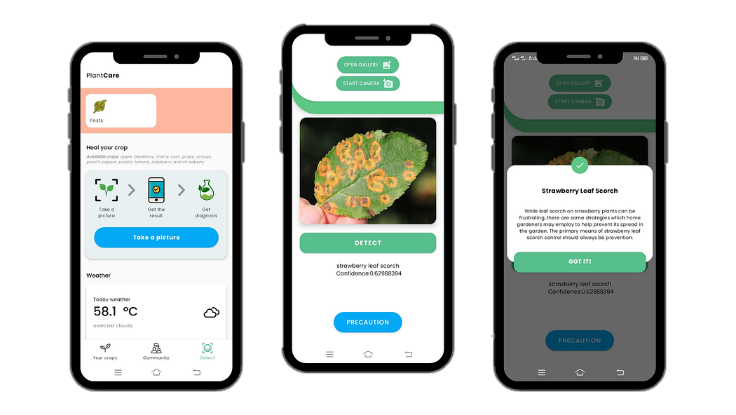
1. Disease Detection
High Accuracy: Transfer-trained MobileNetV2 → 91.14% accuracy.
Wide Coverage: Detects 15+ plant diseases and increasing.
Instant Diagnosis: Upload photo → get results immediately.
Smart Assistance: Gemini agent finds trusted, updated solutions.
Farmer-Centric: Simplified, organic-first advice.
Complete Workflow: From photo → detection → solutions in one flow.
Systemic Inefficiency: The fragmented supply chain leads to inflated consumer prices and frustrated farmers who cannot sell their produce fairly.
Farmer Protest: The sheer frustration of these issues is evidenced by the frequent farmer protests in Nepal, highlighting a broken system in urgent need of a solution.

Slide 10
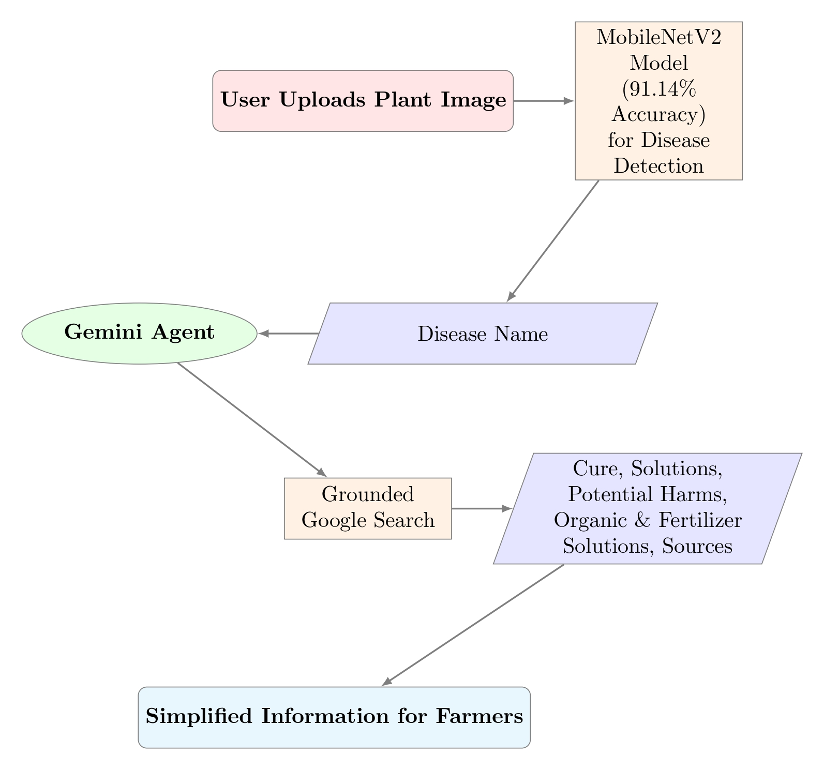
How Farmers Would Use this?
Feature Workflow

Slide 11
Feature Workflow
“First of its kind in Nepal to combine advanced AI disease detection with localized, actionable solutions and sources for farmers.”
Farmers can see a substantial boost in revenue—often between 10% and 50% or more— Source: Market oriented farming: an overview

Slide 12
2. Real Time Crop Recommendation
2. Real Time Crop Recommendation
Farmers can see a substantial boost in revenue—often between 10% and 50% or more— Source: Market oriented farming: an overview

Slide 13
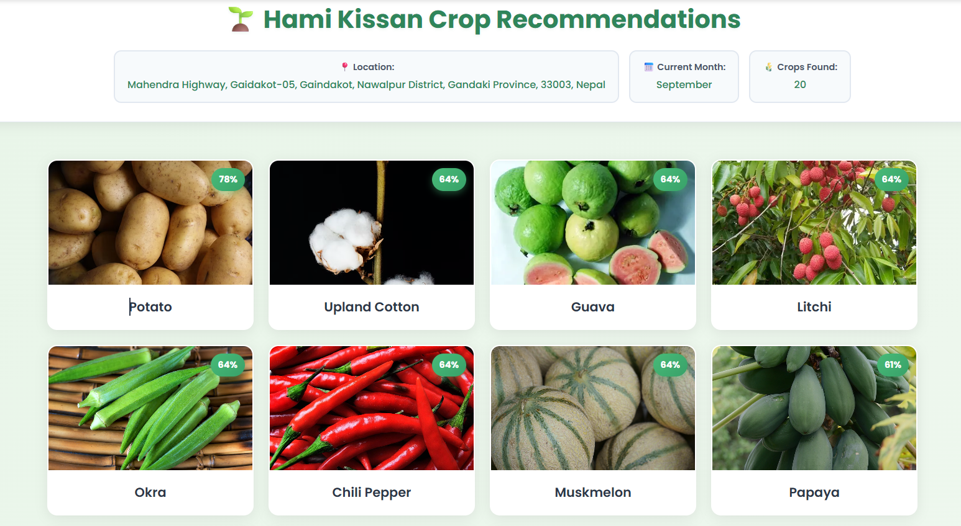
2. Real Time Crop Recommendation
2. Real Time Crop Recommendation
How Farmers Would Use this?
Smart Insights: Uses real-time weather, soil pH, rainfall & altitude data.
Location-Specific: Tailored to each farmer’s exact environment.
Maximizes Yield: Suggests the most viable crops for higher output.
Minimizes Risk: Avoids crops likely to fail or waste resources.
Farmer Empowerment: Delivers clear, data-backed decisions for better farming.

Slide 14
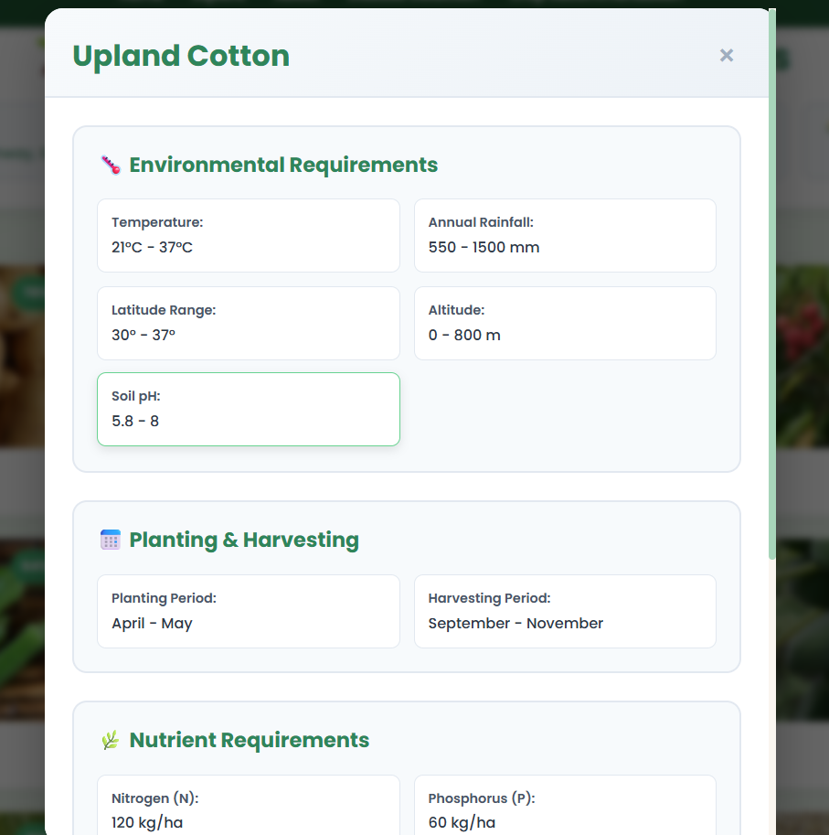
How Farmers Would Use this?

Slide 15
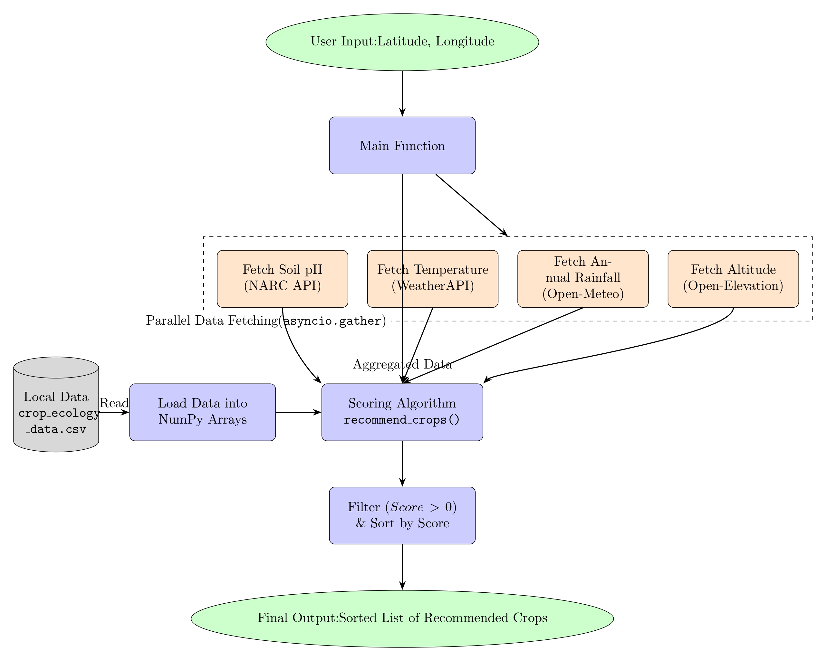
How Farmers Would Use this?
Feature Workflow

Slide 16
Feature Workflow
How Farmers Would Use this?

Slide 17
3. Automated Alerts & Forecasts
3. Automated Alerts & Forecasts
The Problem: Sudden weather shifts or disease outbreaks devastate crops.
How It Works: Real-time monitoring via /weatherforecast & /disease_detection.
The Solution: Instant alerts to farmers in affected areas.
Impact: Farmers take timely action → reduced losses, improved resilience.

Slide 18
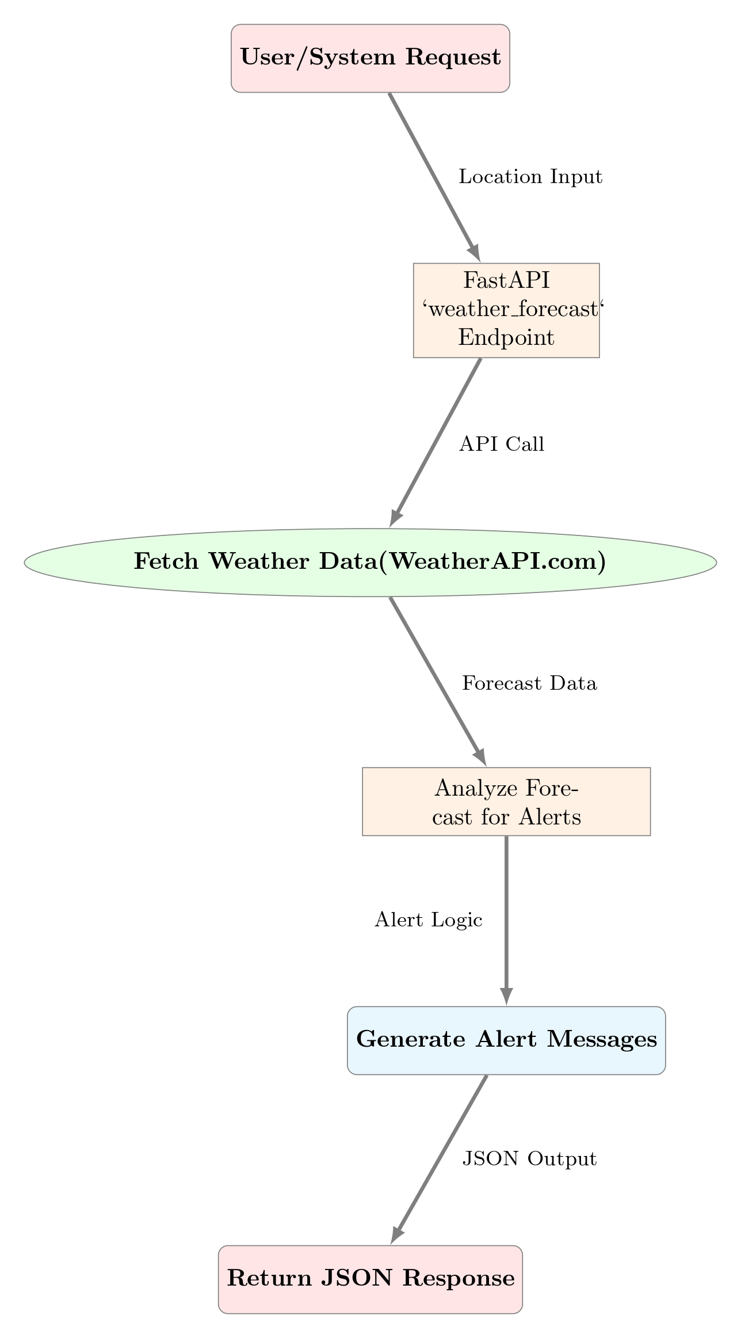
3. Automated Alerts & Forecasts
Feature Workflow
The Problem: Sudden weather shifts or disease outbreaks devastate crops.
How It Works: Real-time monitoring via /weatherforecast & /disease_detection.
The Solution: Instant alerts to farmers in affected areas.
Impact: Farmers take timely action → reduced losses, improved resilience.

Slide 19
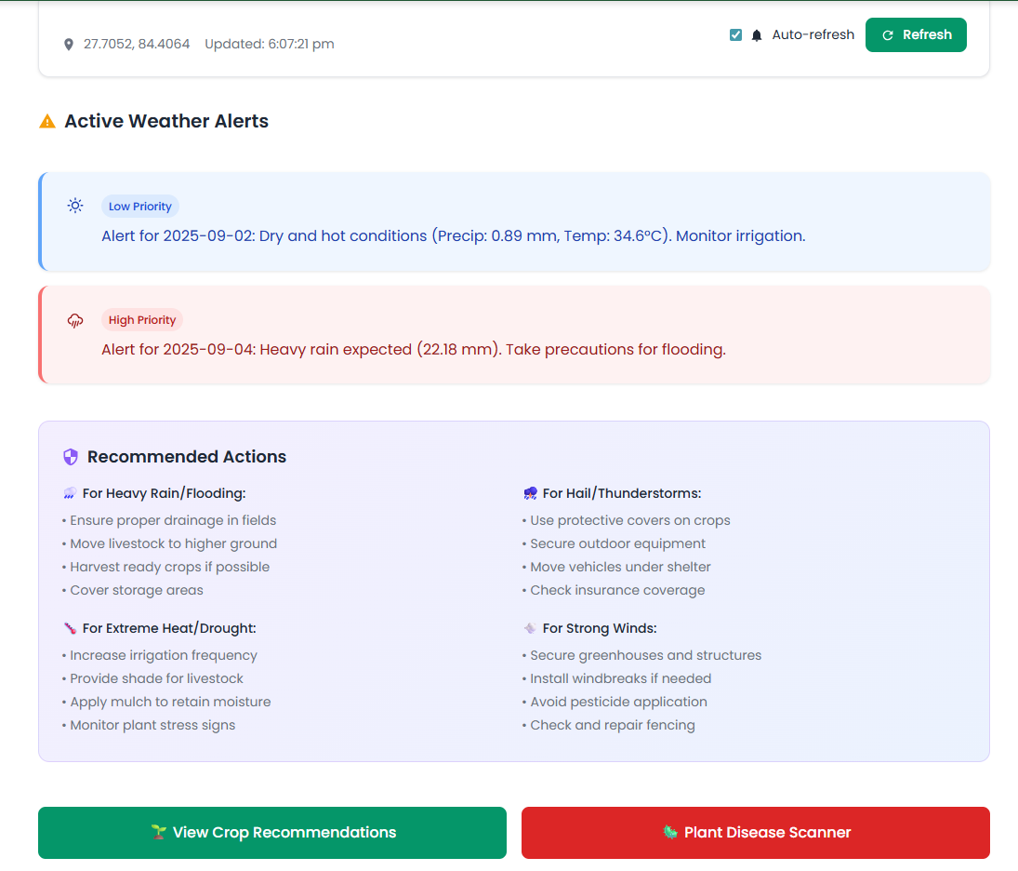
Feature Workflow
3. Automated Alerts & Forecasts
The Problem: Sudden weather shifts or disease outbreaks devastate crops.
How It Works: Real-time monitoring via /weatherforecast & /disease_detection.
The Solution: Instant alerts to farmers in affected areas.
Impact: Farmers take timely action → reduced losses, improved resilience.
How Farmers Would Use this?

Slide 20

How Farmers Would Use this?
Feature Workflow
The Marketplace & Voice Transcription

Slide 21
The Marketplace & Voice Transcription
How Farmers Would Use this?

Slide 22
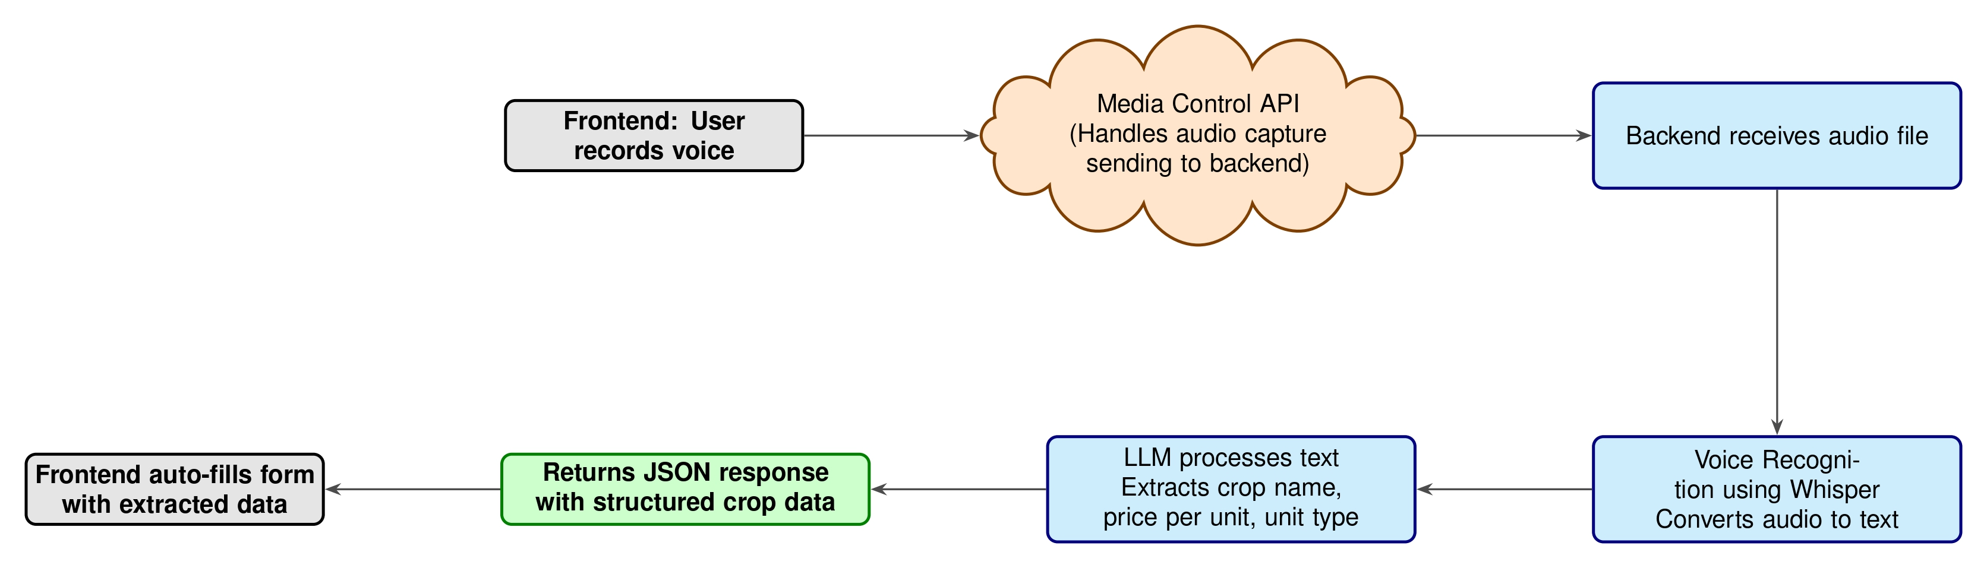
The Marketplace & Voice Transcription
Feature Workflow
Problem: Middlemen take large cuts; farmers lack direct market access.
Innovation: Direct-to-consumer marketplace for fair pricing.
Voice Feature (/transcribe):
Farmers list and navigate produce by speaking
→ easy & accessible.
The Magic: AI transcribes audio, extracts crop, price, quantity, naviagation→ streamlines listing.

Slide 23
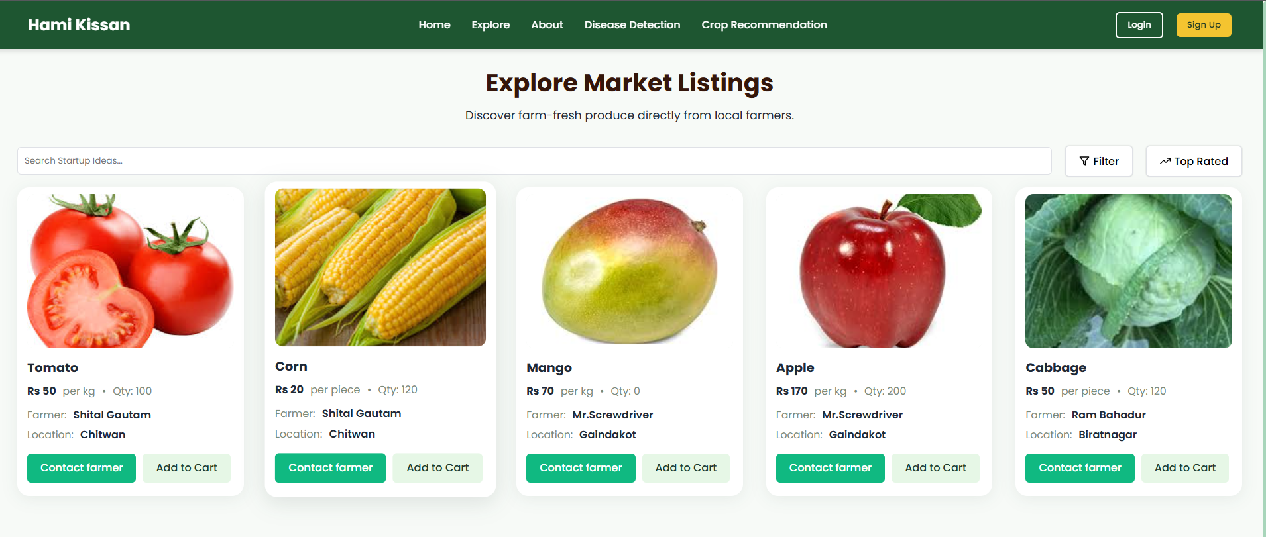
Feature Workflow
The Marketplace & Voice Transcription
How Users would Use this?

Slide 24
How Users would Use this?
How Farmers Create listing

Slide 25
How Farmers Create listing
How Users would Use this?

Slide 26







Proposed Tech Stack
Frontend
Backend
Authentication
React &
Tailwind
Python
(Fast API)
JWTs
Database
Machine Learning & AI
Postgre SQL
Pandas
&
Gemini

Slide 27


Tech Stack
Frontend
Backend
Authentication
Python
(Fast API)
Supabase
Auth
React &
Tailwind
Database
Machine Learning & AI
Supabase
Pytorch
&
Gemini

Slide 28
Future PLANS
Problems

Slide 29



















PRODUCT DEVELOPMENT ROADMAP
Beta Launch & Feedback Loop
Problem Discovery
Core Feature Development
Identified the core challenges facing Nepali farmers: agricultural losses, economic exploitation, and lack of information.
Designed and built the foundational AI-powered features: Disease Detection, Crop Recommendations, and Voice Transcription.
Iterated on the prototype based on user feedback to enhance accuracy, improve UI, and fix bugs.
User & Data Validation
Hackathon Prototype
Full-Scale Public Release
Developed a working prototype to demonstrate the core features and validate the solution with potential users.
Researched market gaps and validated problems with data on crop loss percentages and fragmented supply chains.
Launched a fully functional platform with the integrated marketplace, logistics, and community features to the public.
Future PLANS

Slide 30



Scaling & Sustainability Goal
Business Roadmap
Achieve 1,000 active users. Integrate local logistics and expand regional localization.
AI Marketplace Integration
April 2026
Pilot the AI-powered marketplace, directly connecting farmers with buyers.
Community Hub & Beta Rollout
January 2025
Launch the farmer community forum and beta test proactive alerts. Target 300 active users.
Pilot Phase: User Onboarding
HamiKisaan MVP & Hackathon Launch
Onboard our initial 100 farmers in Gaindakot, gathering crucial feedback for refinement.
October 2025
Our core AI Disease Detection, Crop Recommendation, and Voice Transcription features are live
July 2025
April 2025

Slide 31

DEMO TIME
Problems

